Slide 1
Class 3
Paste transpose
IF Formula with OR/AND
Left, Right, Mid
Find, Search
Materials:
In-Class Workbook

Slide 2
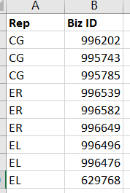
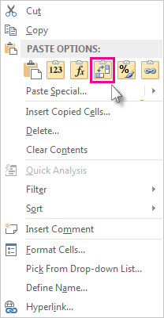

Paste Transpose
If you have a worksheet with data in columns that you want to rotate so it’s rearranged in rows, you can use the Transpose feature. It lets you quickly switch data from columns to rows, or vice versa.
Select the range of data you want to rearrange, including any row or column labels, and press Ctrl+C
Right-click the first cell where you want to paste the data, and pick Transpose
Pick a spot in the worksheet that has enough room to paste your data. The data you copied will overwrite any data that’s already there.
Shortcut = ALT + e + s + e

Slide 3
IF Formula with AND
Regular IF Formula:
=IF(logical_test, [value_if_true], [value_if_false])
If we add more than one logical test separated by commas, ALL of the conditions have to be true to get “[value_if_true]”. If one condition isn’t true you’ll get “[value_if_false]”.
=IF(AND(B2="Yes",C2="Yes"),"Golden Customer","Not Engaged")
If Facebook Sync is yes, and Google Sync is yes then give me “Golden Customer” else give me “Not Engaged”

Slide 4
Left, Right
You can use the LEFT, MID, and RIGHT text functions to manipulate strings of text in your data. You can use these formulas to extract certain parts of a cell.
LEFT/RIGHT: Starts from the left/right hand side of the string of characters within the cell.
=Left(cell_with_text,number_of_characters)
=Right(cell_with_text,number_of_characters)
Input the cell reference that contains the text or string
How many characters do you want to extract starting from the right or left side?

Slide 5
Mid
MID: This returns a specific number of characters from a text string, starting at the position you specify, based on the number of characters you specify.
=Mid(cell_with_text,start_position,length)
How many characters do you want to extract to the right of your start_position?
Input the cell reference that contains the text or string
Starting from the right, how many characters into the string do you want to mark as your starting point?

Slide 6
Find Function
FIND function locates one text string within a second text string, and returns the number of the starting position of the first text string from the first character of the second text string.
=FIND(find_text, within_text, [start_num])
** Case sensitive!
Find_text: Required. The text you want to find.
Within_text: Required. The text containing the text you want to find.
Start_num: Optional. Specifies the character at which to start the search. The first character in within_text is character number 1. If you omit start_num, it is assumed to be 1.

Slide 7
Search Function
The SEARCH function locates one text string within a second text string, and returns the number of the starting position of the first text string from the first character of the second text string. It takes the same arguments as the FIND function.
=SEARCH(find_text,within_text,[start_num])
To find the position of the letter "n" in the word "printer", you can use the following function:
=SEARCH("n","printer")
This function returns 4 because "n" is the fourth character in the word "printer.“
You can also search for words within other words. For example, the function
=SEARCH("base","database")
This returns 5, because the word "base" begins at the fifth character of the word "database".
** NOT case sensitive

Slide 8
References
Full list of text functions

